Slide 1
Candle in the sound
A lighted candle is put in front of a speaker
The speaker makes a sound wave.
The sound wave makes the candle flame flicker.

Slide 2
Candle in the sound
Predict
How will the candle flame move differently if the sound wave is made louder?
How will it move differently if the frequency of the sound wave is made higher?
Explain
Explain why you think this will happen.

Slide 3
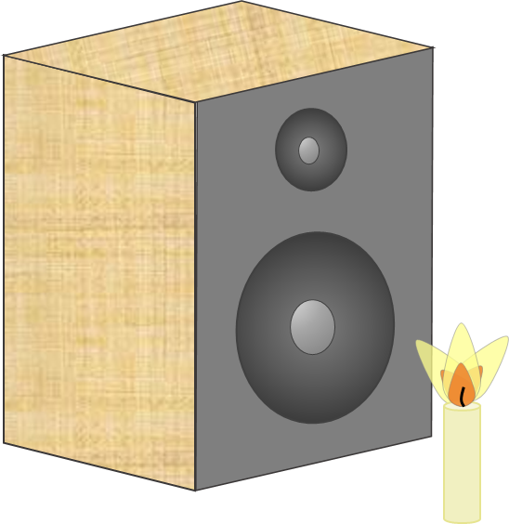
Candle in the sound
Watch a demonstration of the investigation
Observe
Describe what happens to the candle flame when the sound wave is made louder, and when the frequency of the sound wave is increased.
Explain
Were your predictions and explanations correct?
Try to improve your first explanations to explain what happened more clearly.

